Slide 1
CS171 Tutorial4 Ray Tracing Basics
YiHeng Wu

Slide 2
-1. HW2

Slide 3
HW2
Today is 10/26
DDL is 10/28

Slide 4
0. How to Learn Ray Tracing

Slide 5
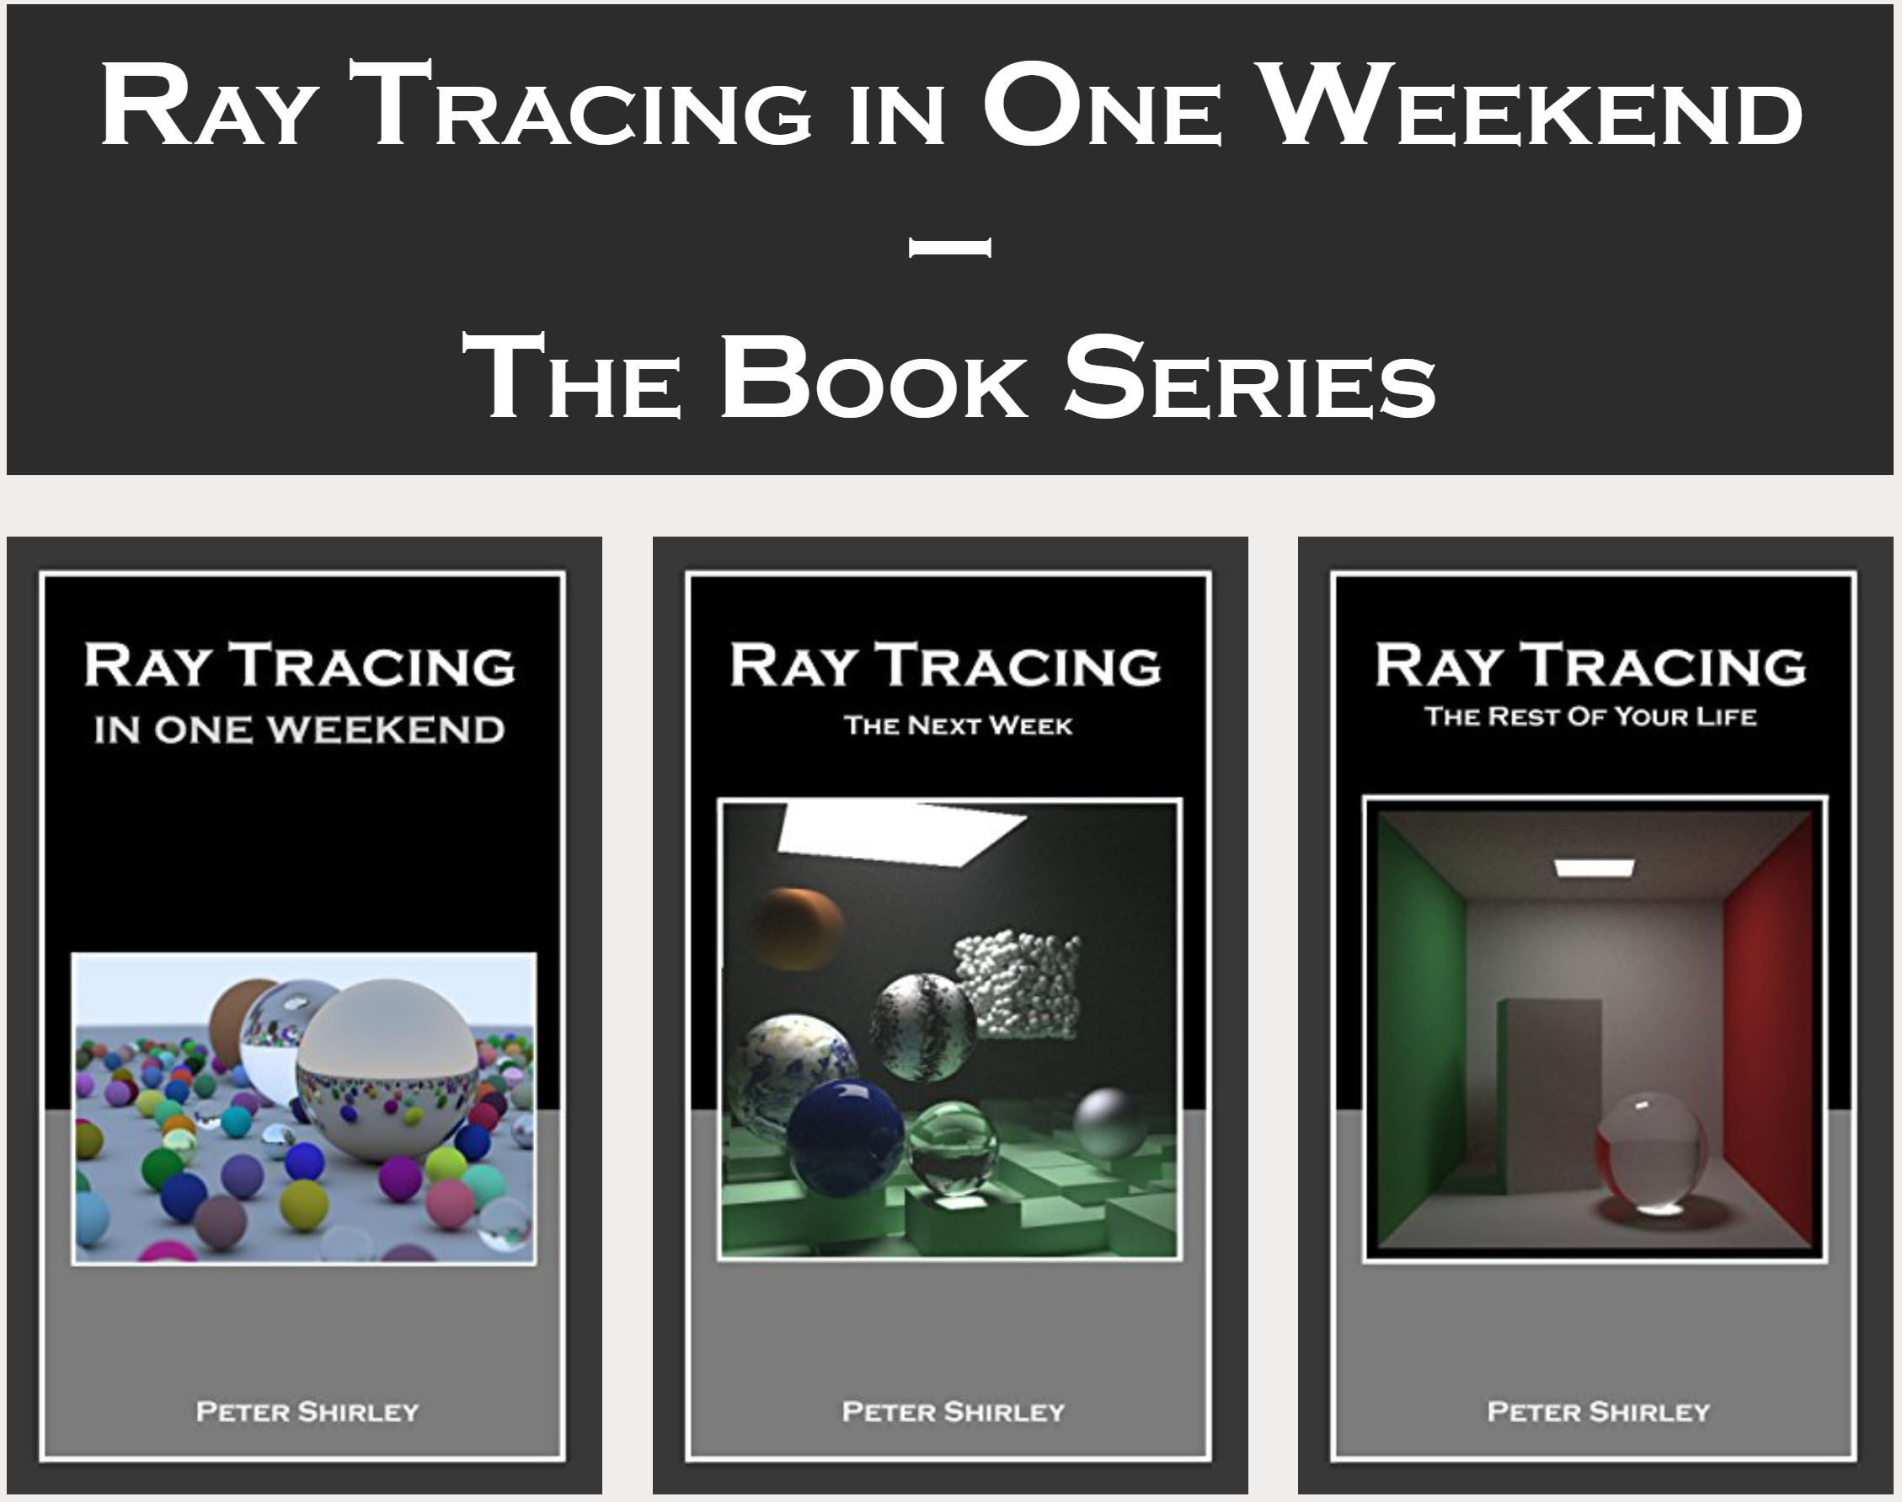
How to Learn Ray Tracing
Step1: The best hello-world tutorial
Ray Tracing in One Weekend Series

Slide 6
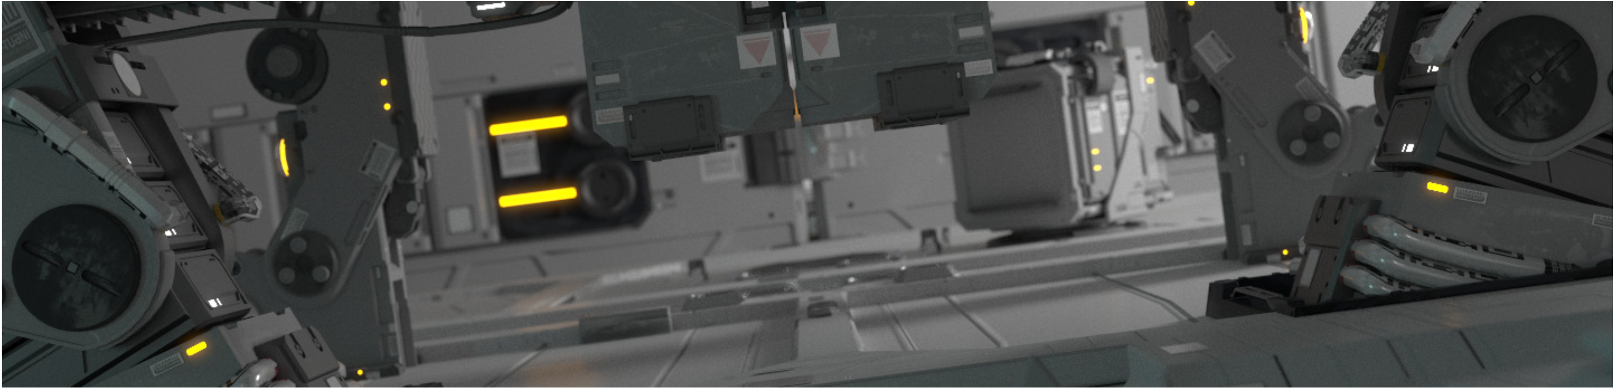
How to Learn Ray Tracing
Step1: The best hello-world tutorial
Ray Tracing in One Weekend Series
Step2: PBRT
advanced global illumination - Search (pbr-book.org)

Slide 7
1. How to generate an image?

Slide 8
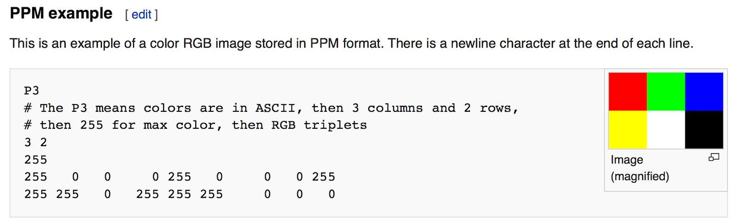
How to generate an image?
PPM
You even don’t need any library

Slide 9
How to generate an image?
PPM
PNG / JPG
stb_image

Slide 10
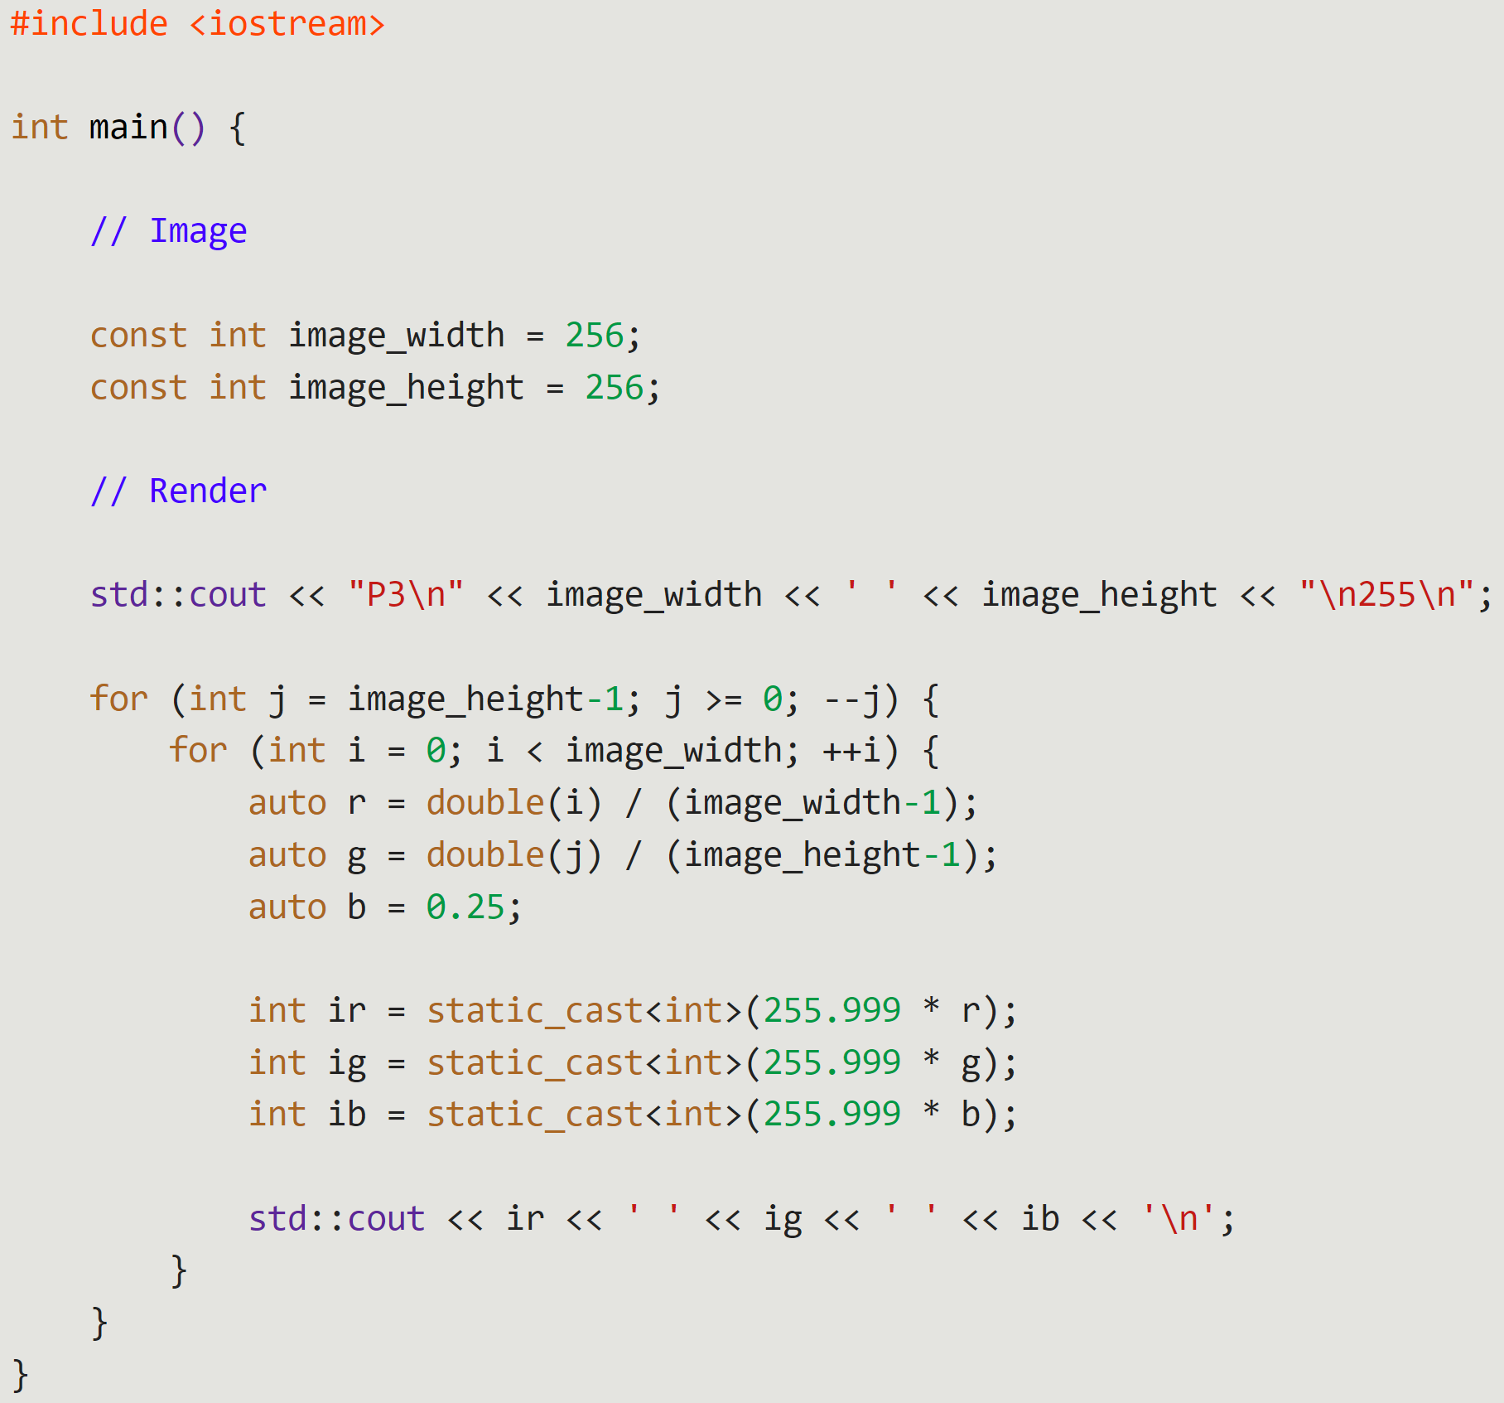
How to generate an image?
PPM
PNG / JPG
Hello world
Copy them into main.cpp
g++ main.cpp
./a.out > image.ppm

Slide 11
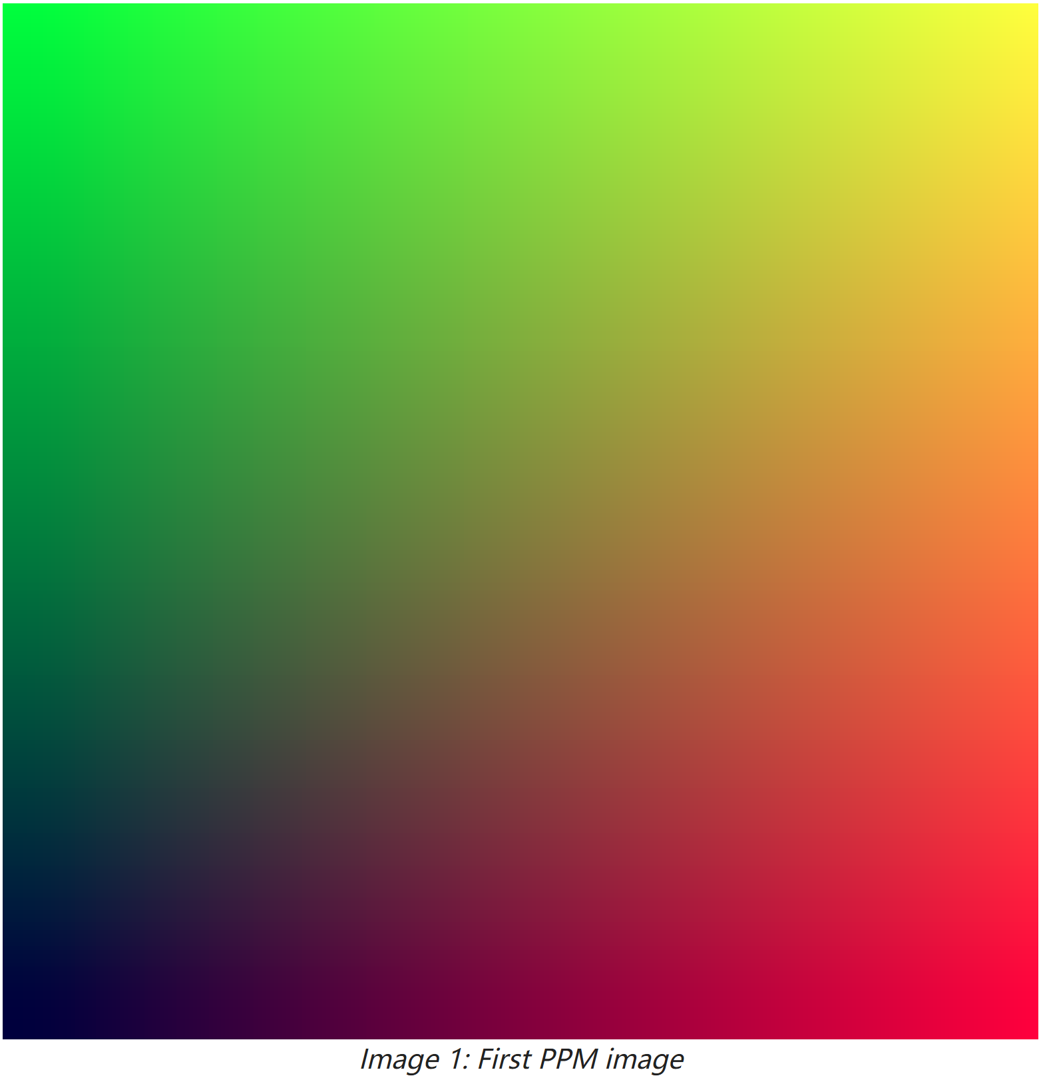
How to generate an image?
PPM
PNG / JPG
Hello world
Copy them into main.cpp
g++ main.cpp
./a.out > image.ppm

Slide 12
2. How to Generate Rays?

Slide 13
How to Generate Rays?
From world coordinate of the camera
To world coordinate of the pixel

Slide 14
How to Generate Rays?
From world coordinate of the camera
To world coordinate of the pixel
One pixel may have many rays

Slide 15
How to Generate Rays?
From world coordinate of the camera
To world coordinate of the pixel
One pixel may have many rays
But what is the world coordinate of the pixel?
Next tutorial
Ray Tracing in One Weekend Series

Slide 16
3. Ray-Shape Intersection

Slide 17
Ray-Shape Intersection
RayCast()
bool RayCast(const Ray& ray, const Triangle& triangle, Float& t) {
...
}
bool RayCast(const Ray& ray, const std::vector<Triangle>& triangles, Float& t) {
bool hit = false;
for (const auto& triangle : triangles) {
if (RayCast(ray, triangle, t))
hit = true;
}
return hit;
}

Slide 18
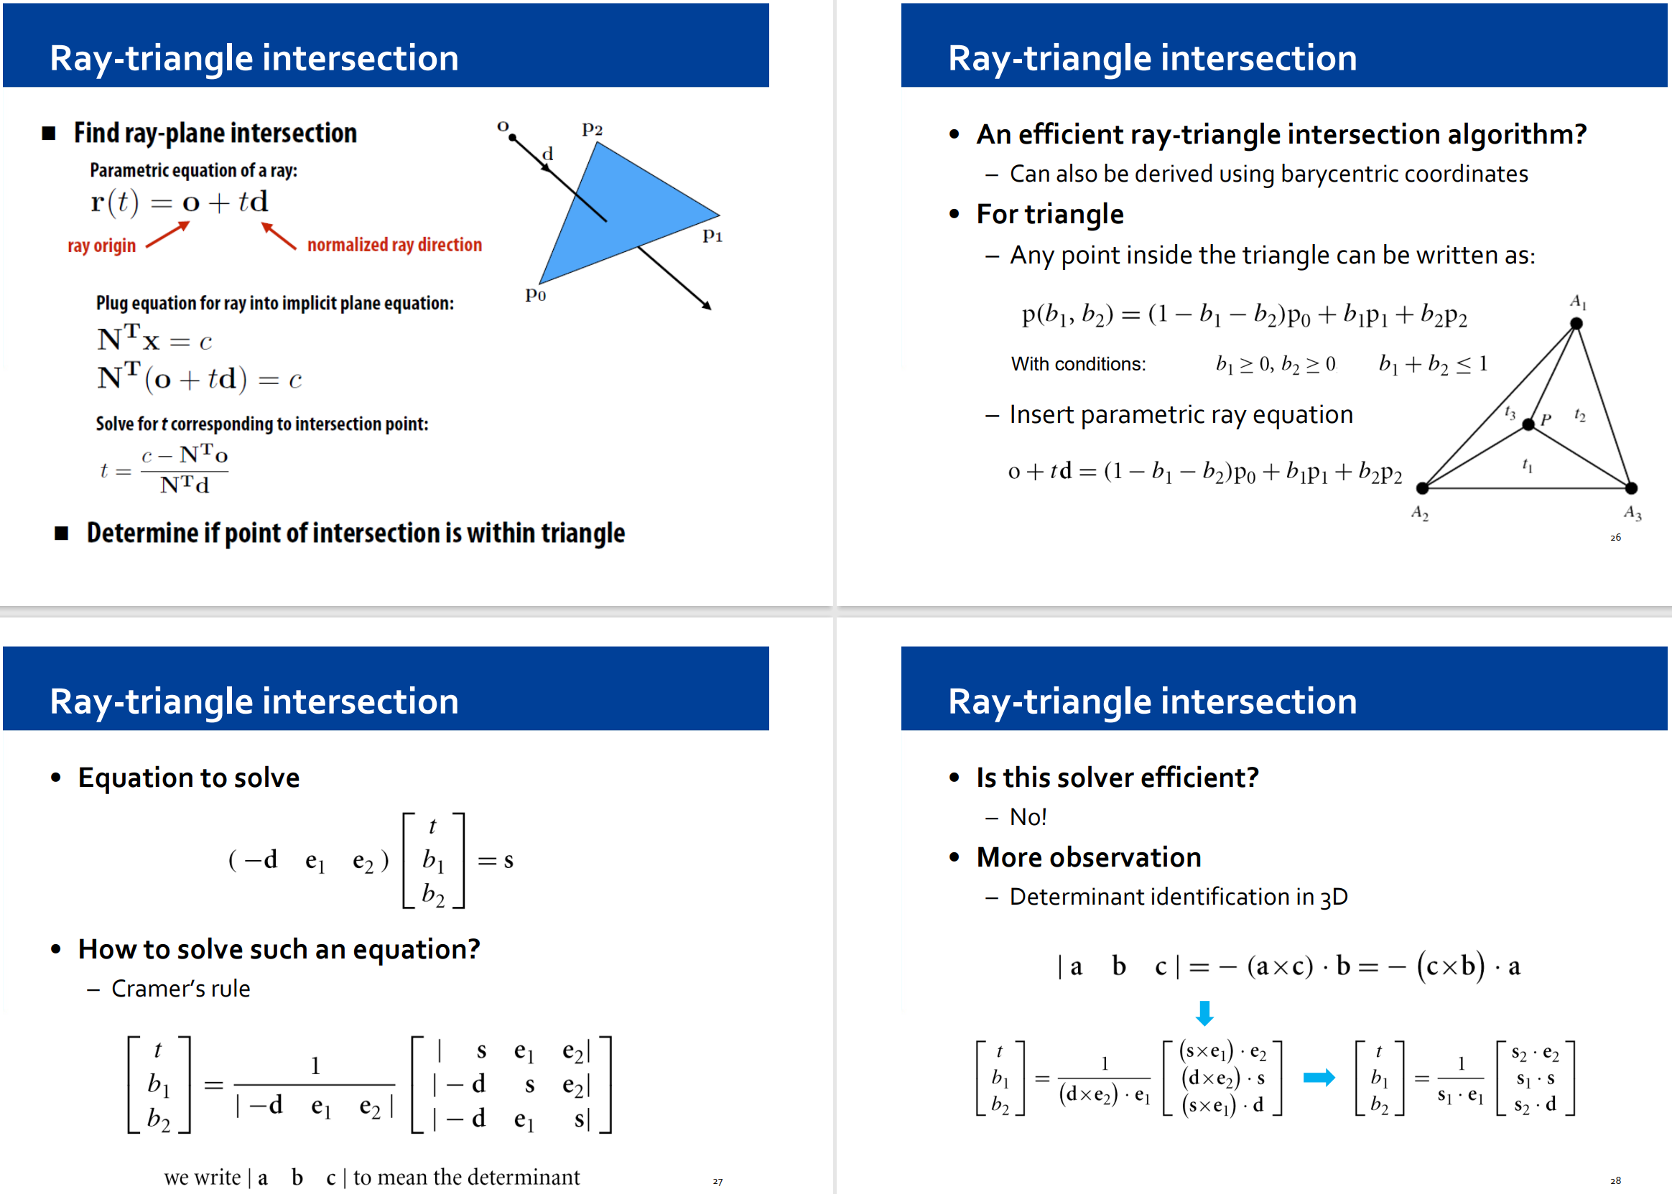
Ray-Shape Intersection
RayCast()
Ray-triangle intersection
bool RayCast(const Ray& ray, const Triangle& triangle, Float& t) {
...
}

Slide 19
Ray-Shape Intersection
RayCast()
Ray-triangle intersection
Ray-casting results
class RayCastResult {
public:
Float t;
size_t triangle_hit;
Vector3f normal;
};

Slide 20
Ray-Shape Intersection
bool RayCast(const Ray& ray,
const std::vector<Triangle>& triangles,
RayCastResult& result) {
bool hit = false;
size_t triangle_hit = -1;
Float t = result.t;
for (size_t i = 0; i < triangles.size(); ++i) {
if (RayCast(ray, triangles[i], t)) {
hit = true;
triangle_hit = i;
}
}
if (hit) {
result.t = t;
result.triangle_hit = triangle_hit;
result.normal = ...;
}
return hit;
}
RayCast()
Ray-triangle intersection
Ray-casting results
hit到的点的normal

Slide 21
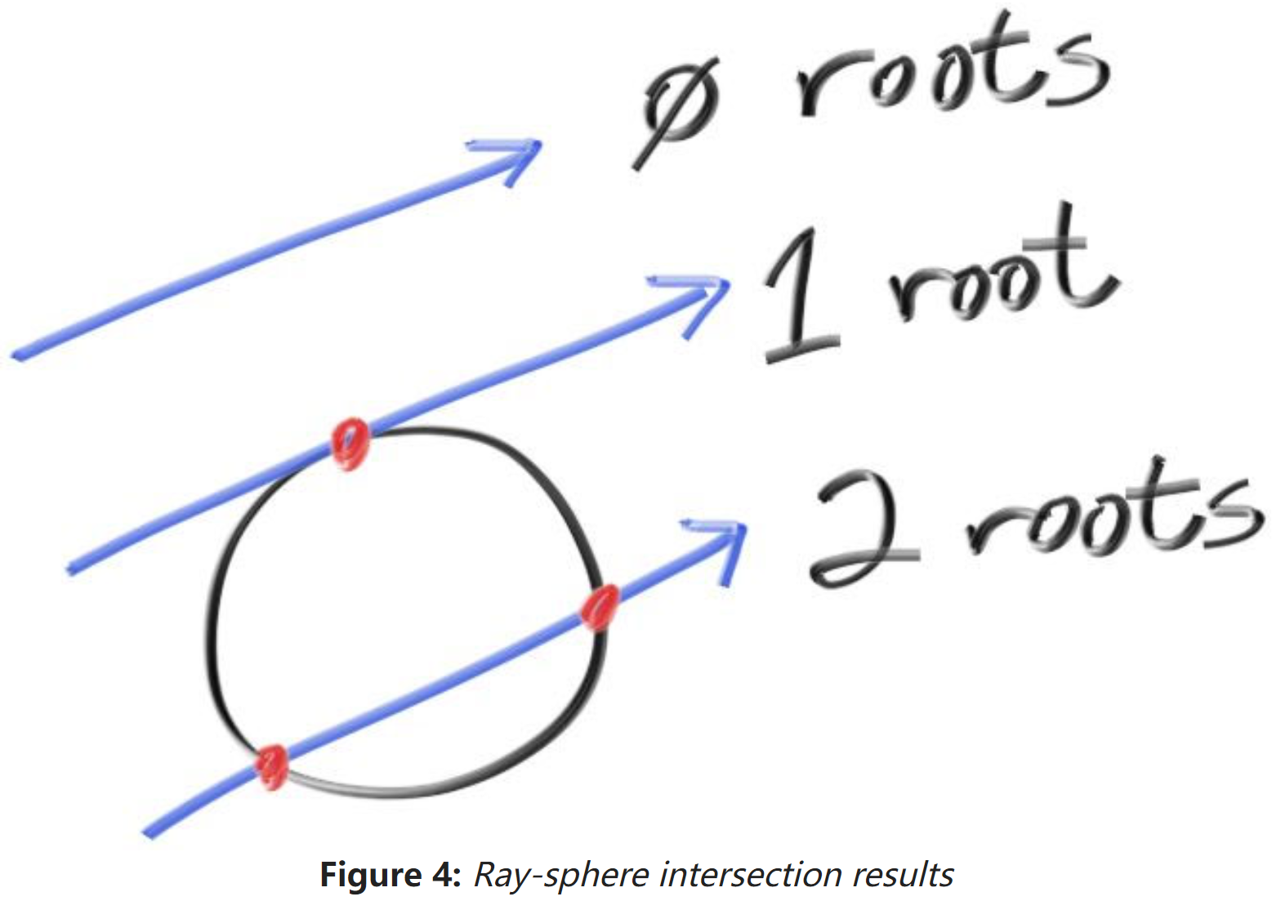
Ray-Shape Intersection
RayCast()
Ray-triangle intersection
Ray-casting results
Ray-sphere / cube intersection?
Option1: Mathematics
Option2: Discretization

Slide 22
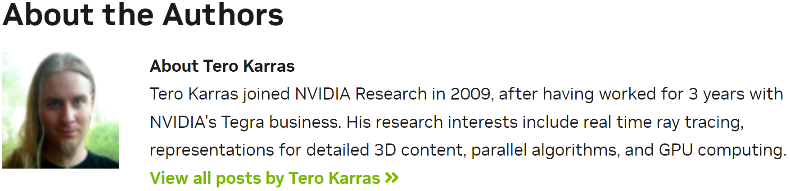
Ray-Shape Intersection
RayCast()
Ray-triangle intersection
Ray-casting results
Ray-sphere / cube intersection?
Option1: Mathematics
Option2: Discretization
Accelerators
Future tutorials
Thinking Parallel, Part I: Collision Detection on the GPU | NVIDIA Technical Blog
[2012] Maximizing Parallelism in the Construction of BVHs, Octrees, and k-d Trees

Slide 23
4. Texture

Slide 24
Texture
More ray-casting results
class RayCastResult {
public:
Float t;
size_t triangle_hit;
Vector3f normal;
Vector2f uv;
};

Slide 25
Texture
More ray-casting results
bool RayCast(const Ray& ray,
const std::vector<Triangle>& triangles,
RayCastResult& result) {
...
for (size_t i = 0; i < triangles.size(); ++i) {
...
}
if (hit) {
result.t = t;
result.triangle_hit = triangle_hit;
result.normal = ...;
result.uv = ...;
}
return hit;
}

Slide 26
Texture
More ray-casting results
Texture system
Virtual functions will make the code slower
But CPU texture evaluation is MUCH faster than CPU ray-casting
class Texture {
public:
virtual bool Evaluate(const Vector2f& uv) = 0;
private:
...
};

Slide 27
Texture
More ray-casting results
Texture system
class SingleImageTexture : public Texture {
public:
virtual bool Evaluate(const Vector2f& uv) override {
...
}
private:
...
};
class MIPMap : public Texture {
public:
virtual bool Evaluate(const Vector2f& uv) override {
...
}
private:
...
};

Slide 28
Texture
More ray-casting results
Texture system
class SingleImageTexture : public Texture {
public:
virtual bool Evaluate(const Vector2f& uv) override {
// trilinear interpolation
}
private:
...
};

Slide 29
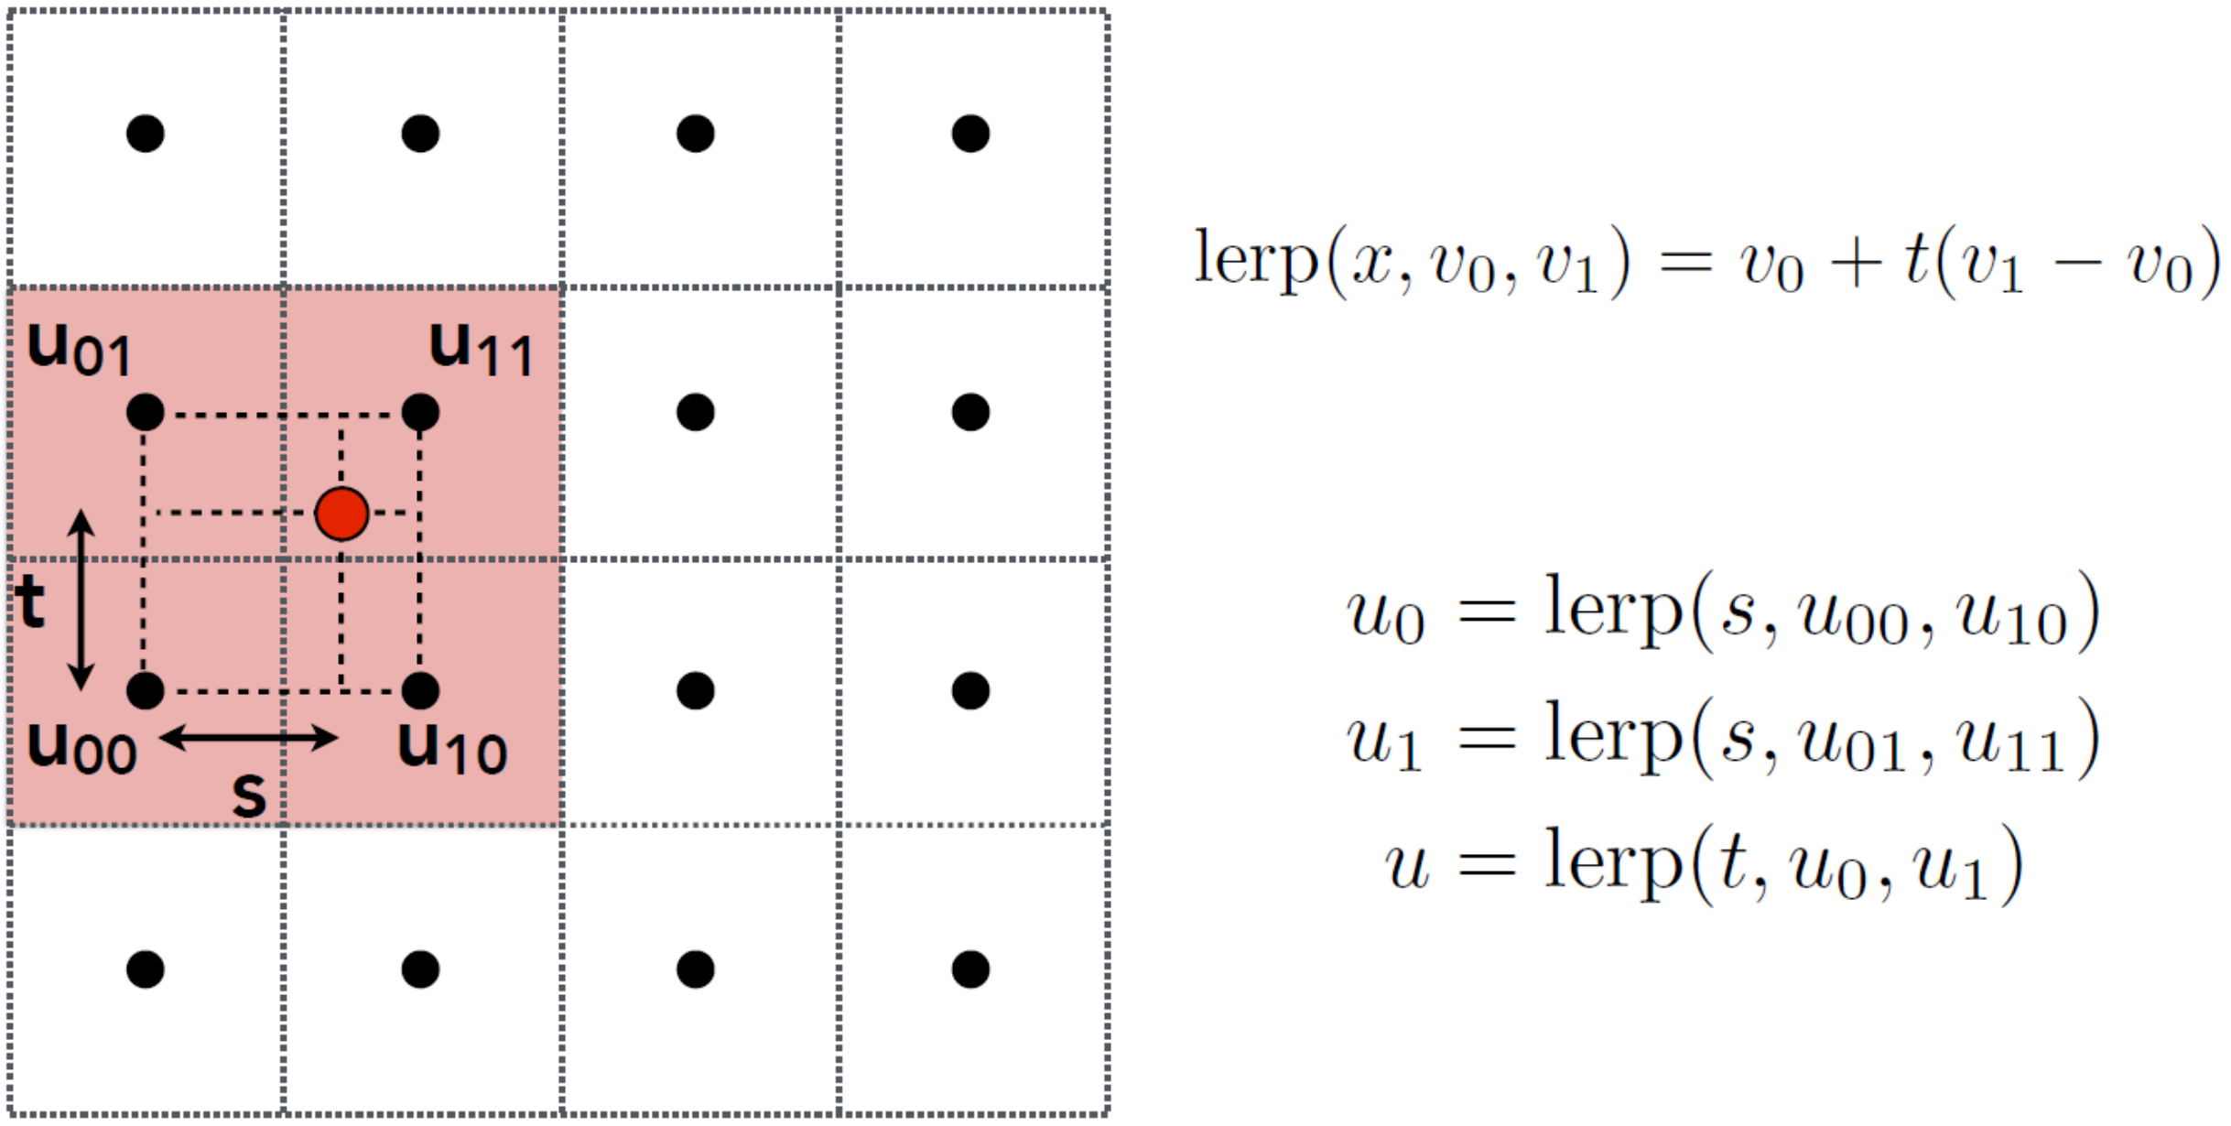
Texture
More ray-casting results
Texture system
Trilinear interpolation

Slide 30
Texture
More ray-casting results
Texture system
class MIPMap : public Texture {
public:
virtual bool Evaluate(const Vector2f& uv) override {
// compute the MIPMap level
// evaluate according to the MIPMap level
}
private:
...
};

Slide 31
Texture
More ray-casting results
Texture system
Normal map
class NormalMap : public MIPMap {
public:
void Apply(RayCastResult& result) {
...
}
private:
...
};

Slide 32
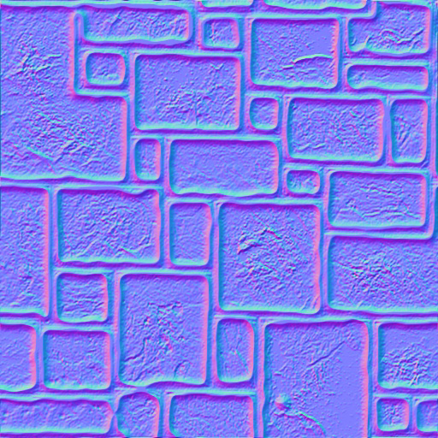
Texture
More ray-casting results
Texture system
Normal map
Why purple?
(r, g, b) = ((n1, n2, n3) + (1, 1, 1)) / 2
Normal(0, 0, 1) -> Color(0.5, 0.5, 1)

Slide 33
Texture
More ray-casting results
Texture system
Normal map
Why purple?
Hint
(0, 0, 1) means no turbulence
How to perturb a normal at world coordinate?
(0,0,1)没有扰动，坐标变换之后仍是本身
构造一个transform矩阵
坐标系统由三个正交向量构成
一个为(0,0,1)；
raycastResult result得到
第三个叉乘

Slide 34
Texture
More ray-casting results
Texture system
Normal map
Why purple?
Hint
(0, 0, 1) means no turbulence
How to perturb a normal at world coordinate?
Maybe you need some coordinate transformation?

Slide 35
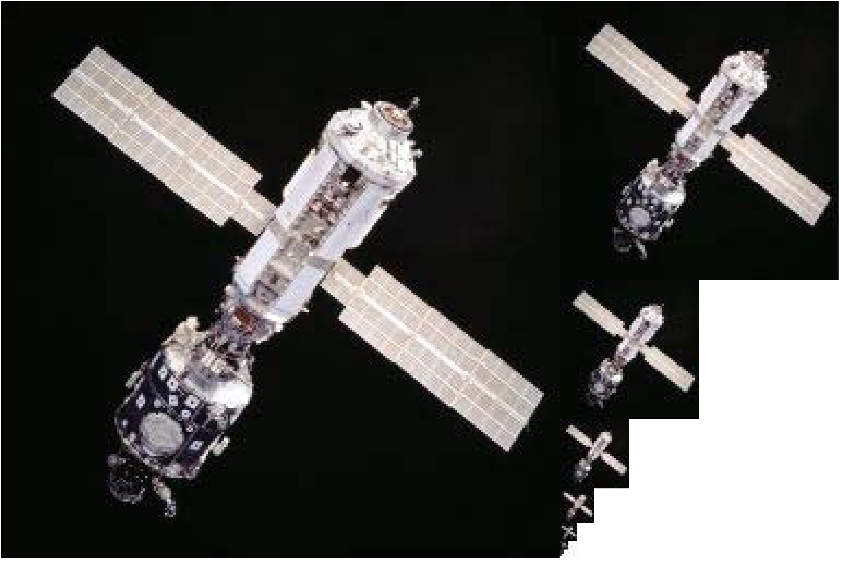
Texture
More ray-casting results
Texture system
Normal map
MIPMap
Generate MIPMap

Slide 36
Texture
More ray-casting results
Texture system
Normal map
MIPMap
Generate MIPMap
Compute MIPMap level
Guess, how to elegantly implement it by ray-casting?
Maybe you also need some coordinate transformation knowledge?

Slide 37
Texture
More ray-casting results
Texture system
Normal map
MIPMap
Generate MIPMap
Compute MIPMap level
Guess, how to elegantly implement it by ray-casting ?
Maybe you also need some coordinate transformation knowledge?
Evaluate texture color

Slide 38
Thank You

